Slide 1
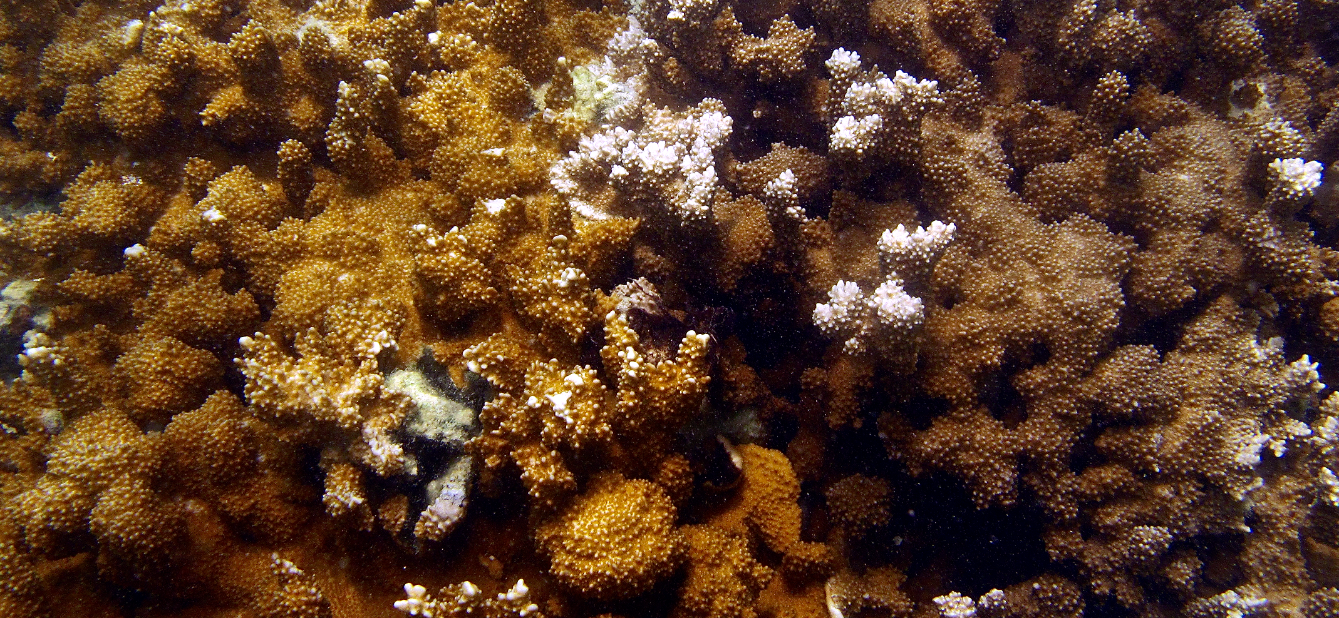
Spatial Distribution of Symbiodinium and Color in Montipora capitata Across Kāne‘ohe Bay, O‘ahu, Hawai‘i
Teegan Innis¹, Ross Cunning², Raphael Ritson-Williams², Chris Wall², Ruth D. Gates²

Slide 2
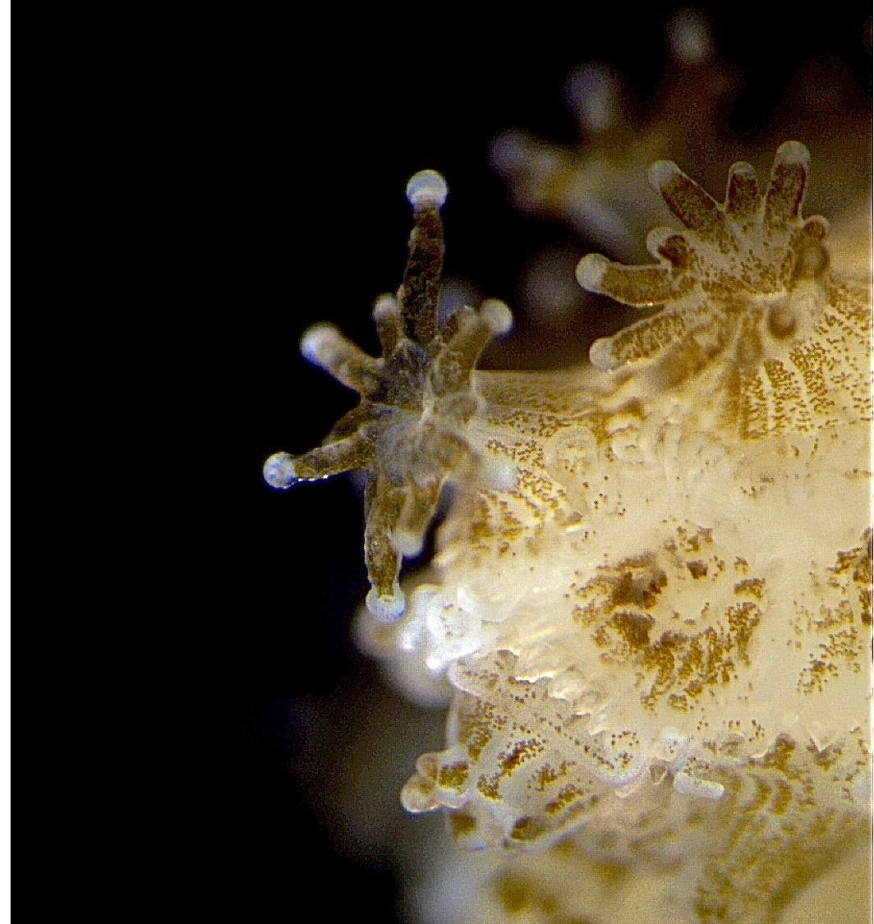
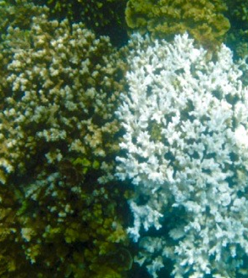
Background
Notes:
Corals form mutualistic endosymbiosis with photosynthetic dinoflagellates - Many coral species only associate with 1 of 9 clades
Montipora capitata associates with clades C and D - Functional differences in C and D – C more efficient carbon and nutrient-delivery to host and D more stress-tolerant
Leveraging Ross’s paper - Symbiont dominance predicts bleaching susceptibility (Cunning et al. 2016) – all bleached colonies C, all D non-bleached – what is the distribution of symbionts across the bay?
M. Capitata is orange and brown

Slide 3
Questions
What spatial variability exists in the symbiont community composition and color morphologies of M. capitata in Kāne‘ohe Bay?
Is the symbiont community composition different between color morphs?
What environmental parameters are likely driving the distribution?

Slide 4
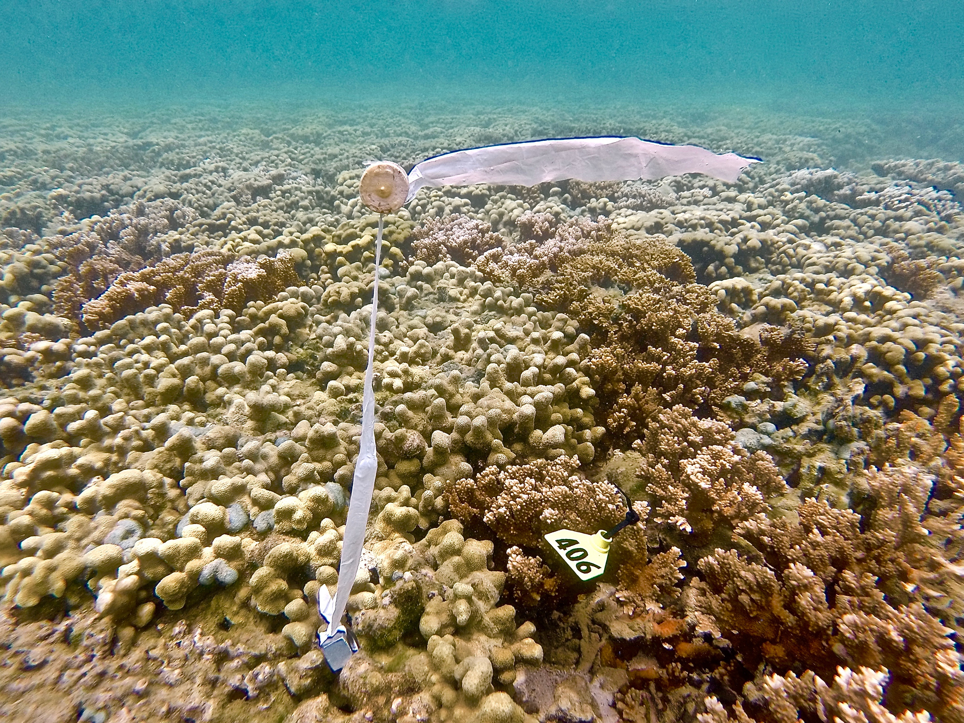
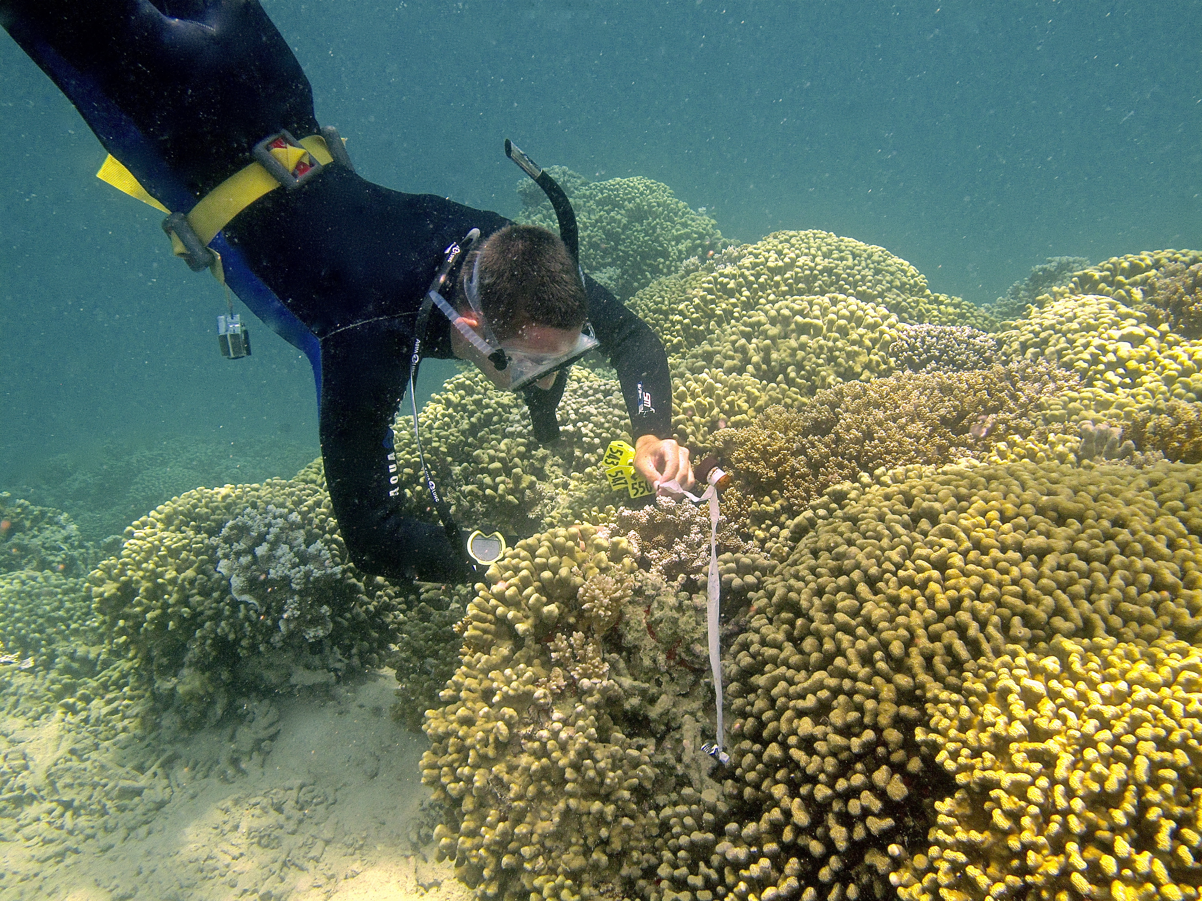
Methods
Tag, sample and photograph colonies in different habitats
Visual assignment of color morph
Quantitative PCR Clade C:D ratio
Notes:
qPCR looking simply at dominance of C or D and relative ratio of C:D in each colony – duplicate reactions (clade in 1 replicate not considered present in colony)

Slide 5
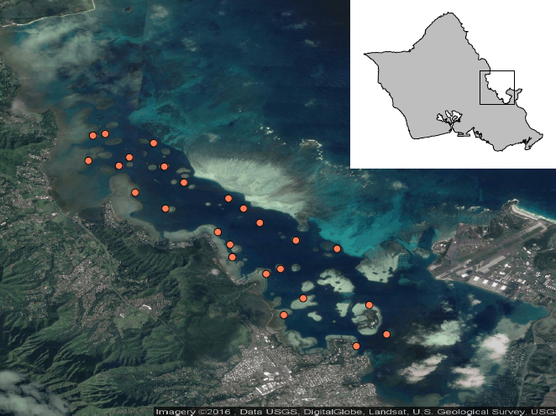
3km
Notes:
16 patch reefs, 9 fringe reefs for a total of 25 sites – 707 total colonies
30 colonies from each patch and 20 from each fringe
Different habitats across regions – increasing oceanic influence, residence time differences, proximity to freshwater influence, differences among patch and fringe

Slide 6
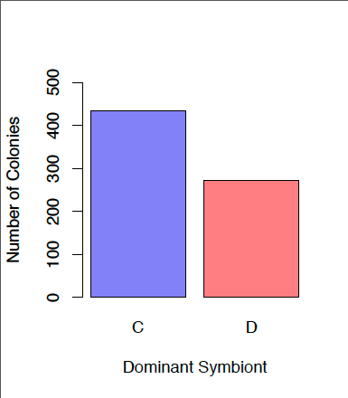
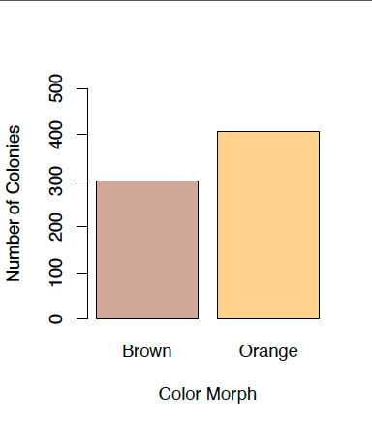
Overall Abundance
Symbiont Clade
Color Morph
n=434
n=407
n=300
n=273
Notes:
C dominated 61% - Orange 57%
Wanted to see if we had samples covering both symbionts and both colors

Slide 7
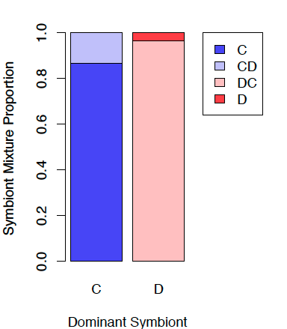
Symbiont Community Composition
n=431
n=276
Of total colonies:
Clade C – 98.7%
Clade D – 46.8%
Notes:
9 colonies D-only – high Ct values (>35 of 40 cycles) even after re-extraction and run through another qPCR and C present in 1 technical replicate in 5 colonies – perhaps D is never exclusive but levels of C association are extremely low?

Slide 8
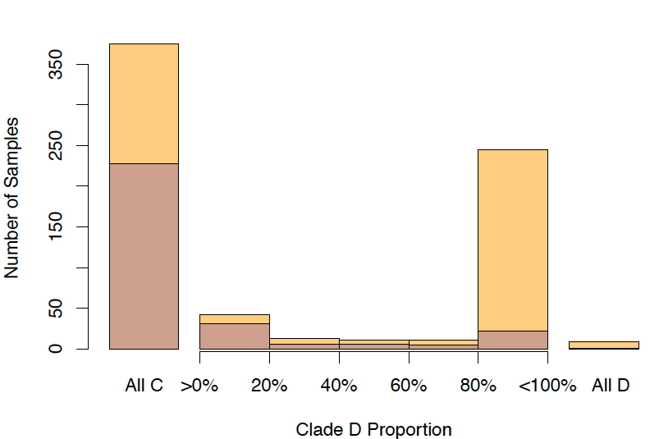
Symbiont Community Composition per Color Morph
Notes:
When D present, typically in abundance >80% indicating D-dominated colony – even mixtures highly dominated by 1 symbiont
C-dominance in 89% brown colonies, D-dominance in 59% orange colonies

Slide 9
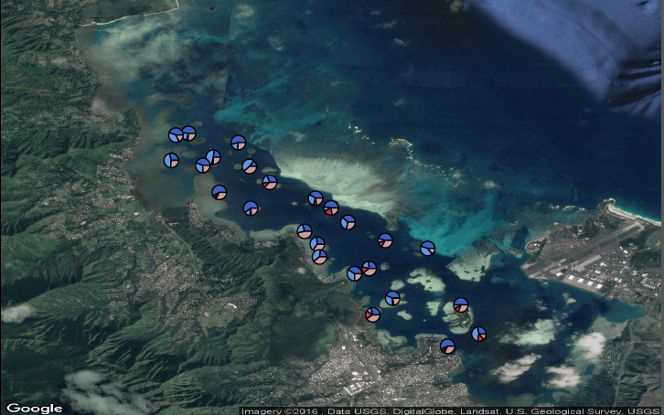
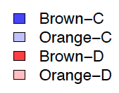
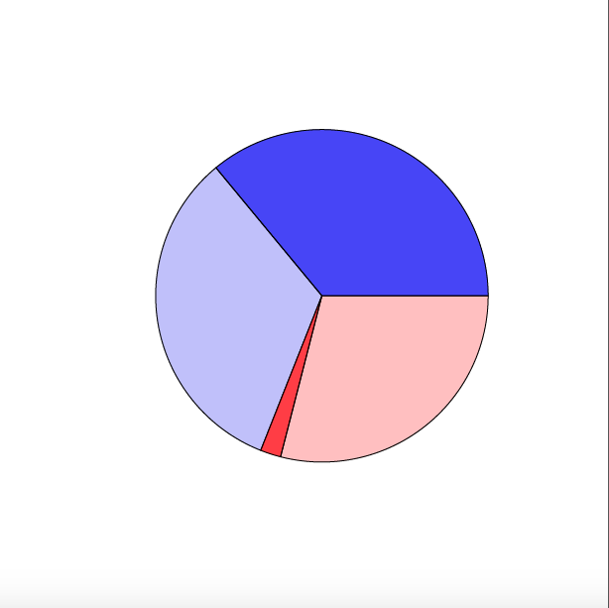
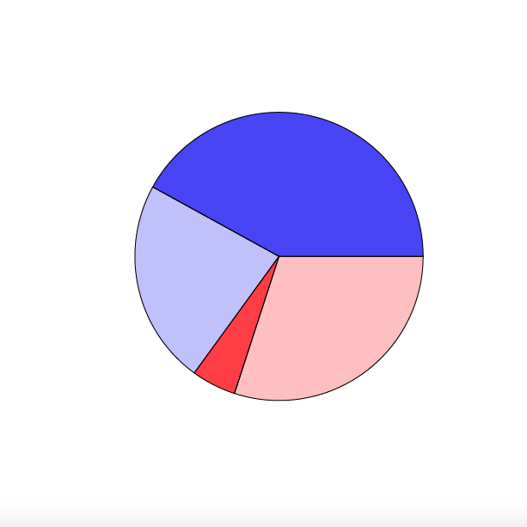
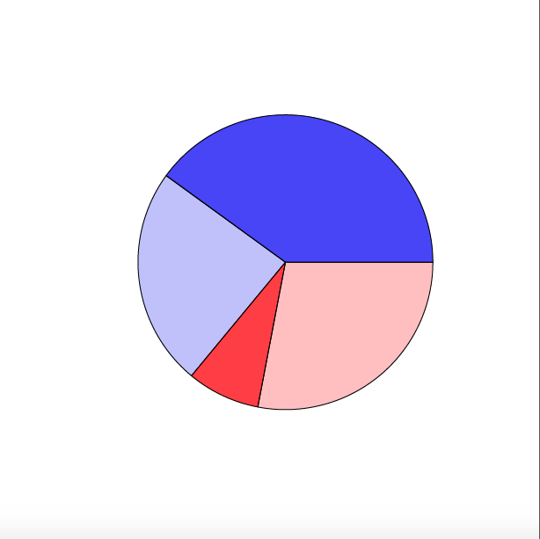
North
Central
South
Notes:
Depth-corrected spatial distributions across the bay – adjusted using NOAA daily mean tide tables for differences in mean sea level – multinomial logistic regression to eliminate depth influence (assume all colonies collected from same depth)
Only spatial pattern is with color and symbiont across regions, driven by brown colonies with D increasing from north to south – only 33 colonies driving this pattern

Slide 10
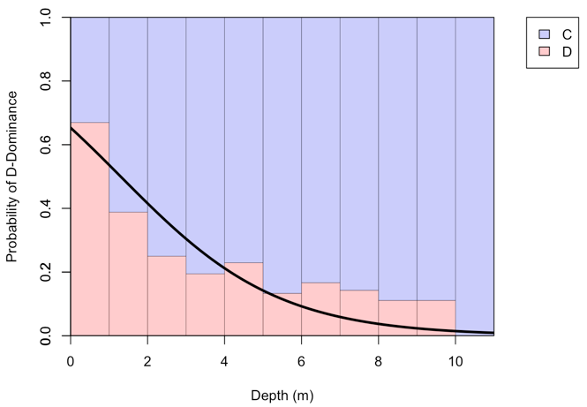
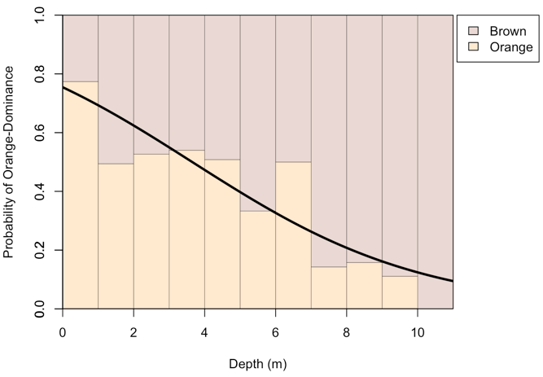
Depth Distributions
Symbiont Dominance
Color Morph
Notes:
Bars indicate relative frequency of symbiont dominance when pooling all samples across 1m depth intervals
Line indicates probability of being dominated by D – depth threshold at 1.29 m – did not vary significantly across reefs or regions
Bars indicate relative frequency of color morph dominance when pooling all samples across 1m depth intervals
Line indicates probability of being dominated by orange – depth threshold at 3.64m – did not vary significantly across reefs or regions
Both apparently responding to abiotic conditions variable with depth as an adaptive mechanism to environmental conditions

Slide 11
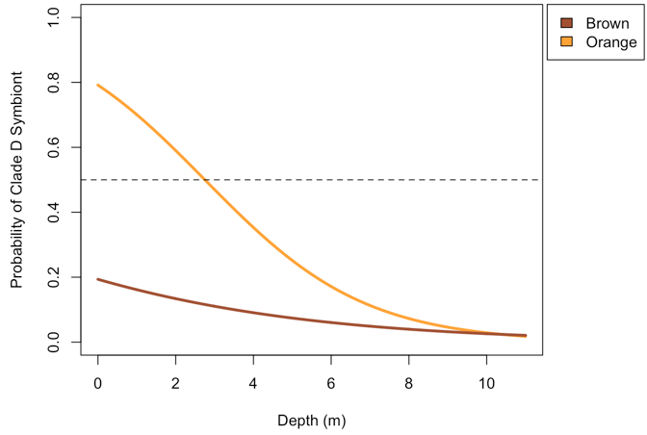
Depth Influence on Dominant Symbiont and Color Morph
*2.75m
p < 0.001
*
Notes:
Again, threshold varies at each individual reef, yet not significantly
Interaction between the 2? – is there a causing agent? – or are both similarly responsive to environmental agents?

Slide 12
Conclusions
Orange, Brown, C-, and D-dominated colonies equally prevalent across Kāne‘ohe Bay
Depth drives both symbiont and color morph distributions
Potential adaptive mechanism to variable environmental conditions
Notes:
Light attenuation with depth is probable candidate though temperature, freshwater lensing, etc. are also potential influences

Slide 13
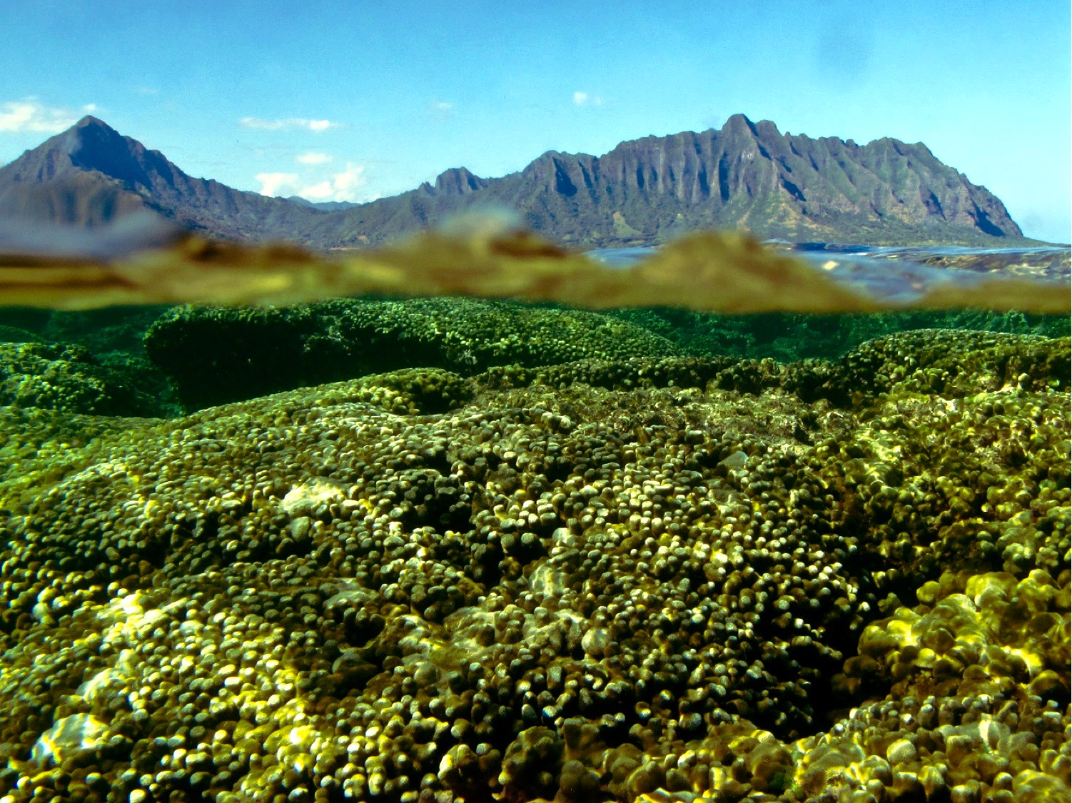
Acknowledgements
Ross Cunning
Raphael Ritson-Williams
Ruth Gates
Chris Wall
My family
Mark Patterson
Jon Grabowksi
Liz Magee
Northeastern University Three Seas Program

